Slide 1

Transportation Data Challenge
Student final dashboards
Trainer: Anh Leimer Training Assistants: Hanna Nguyen, Trang Tran & Hien Tran

Slide 2
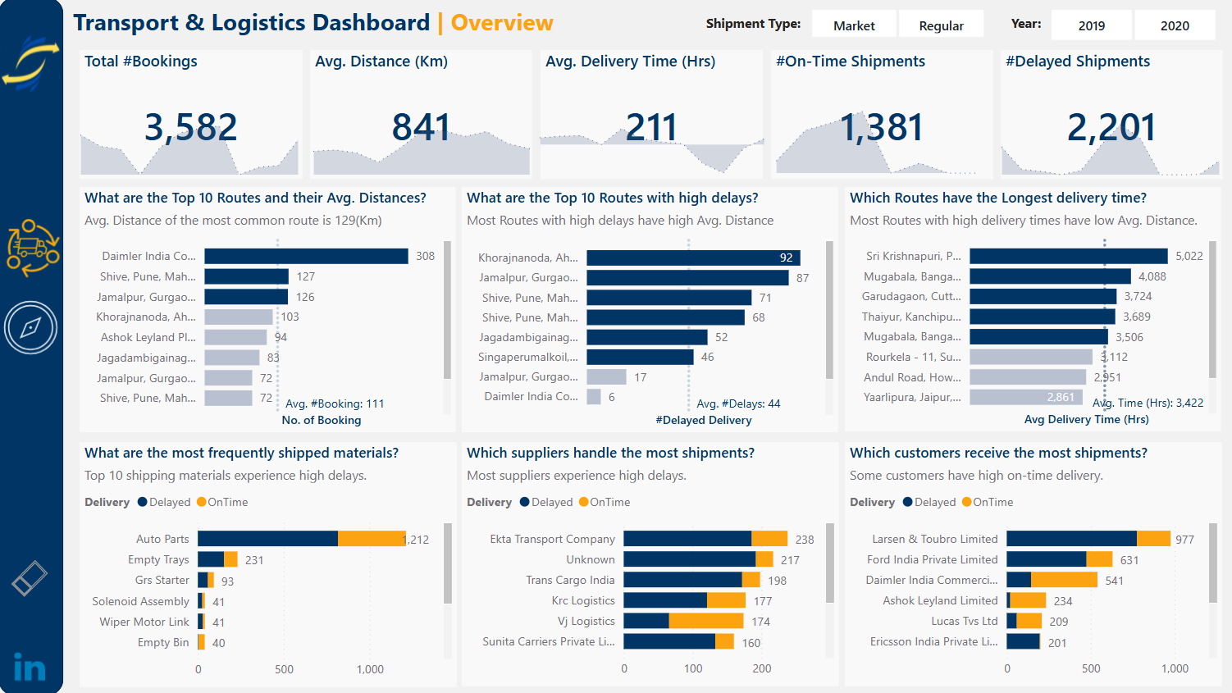
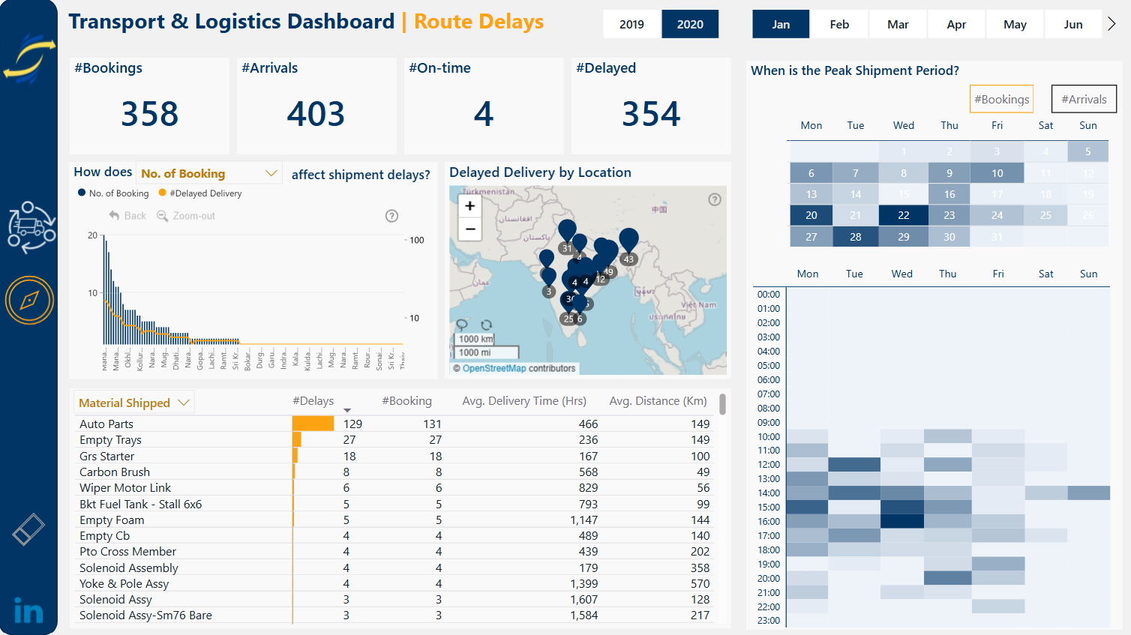
Transportation – FP20 Data Challenge
Link to Linkedin post by Chidera Ozoh

Slide 3
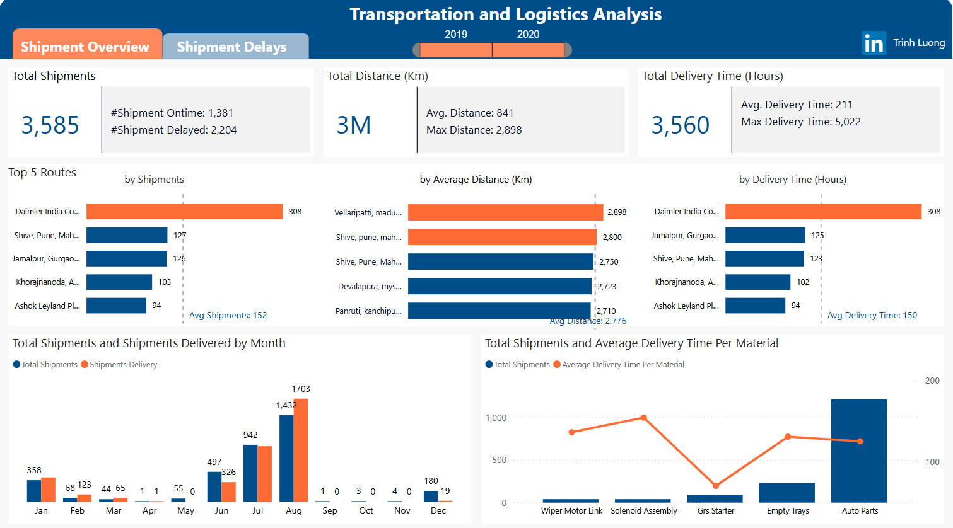
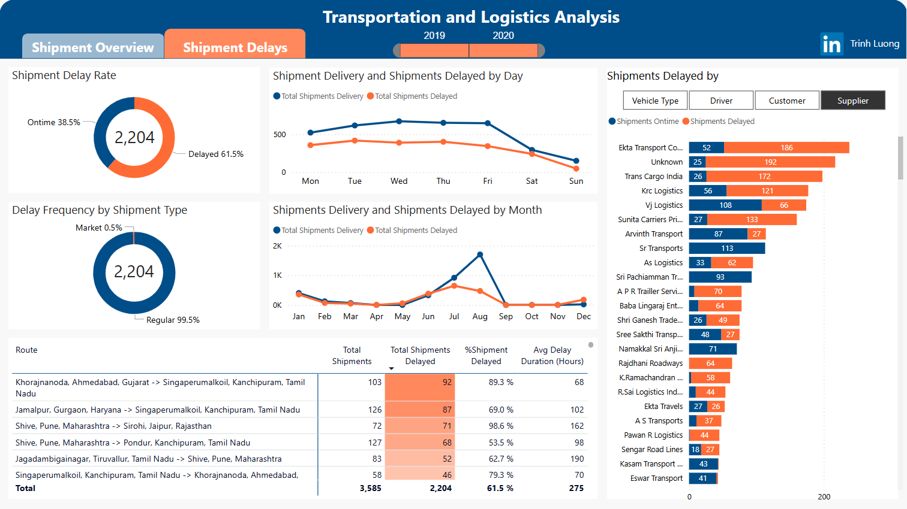
Transportation – FP20 Data Challenge
Link to Linkedin post by Trinh Luong

Slide 4
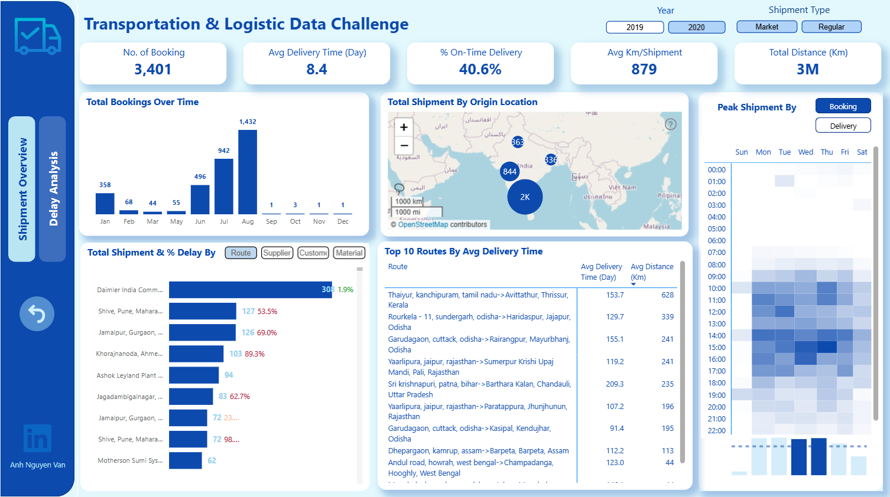
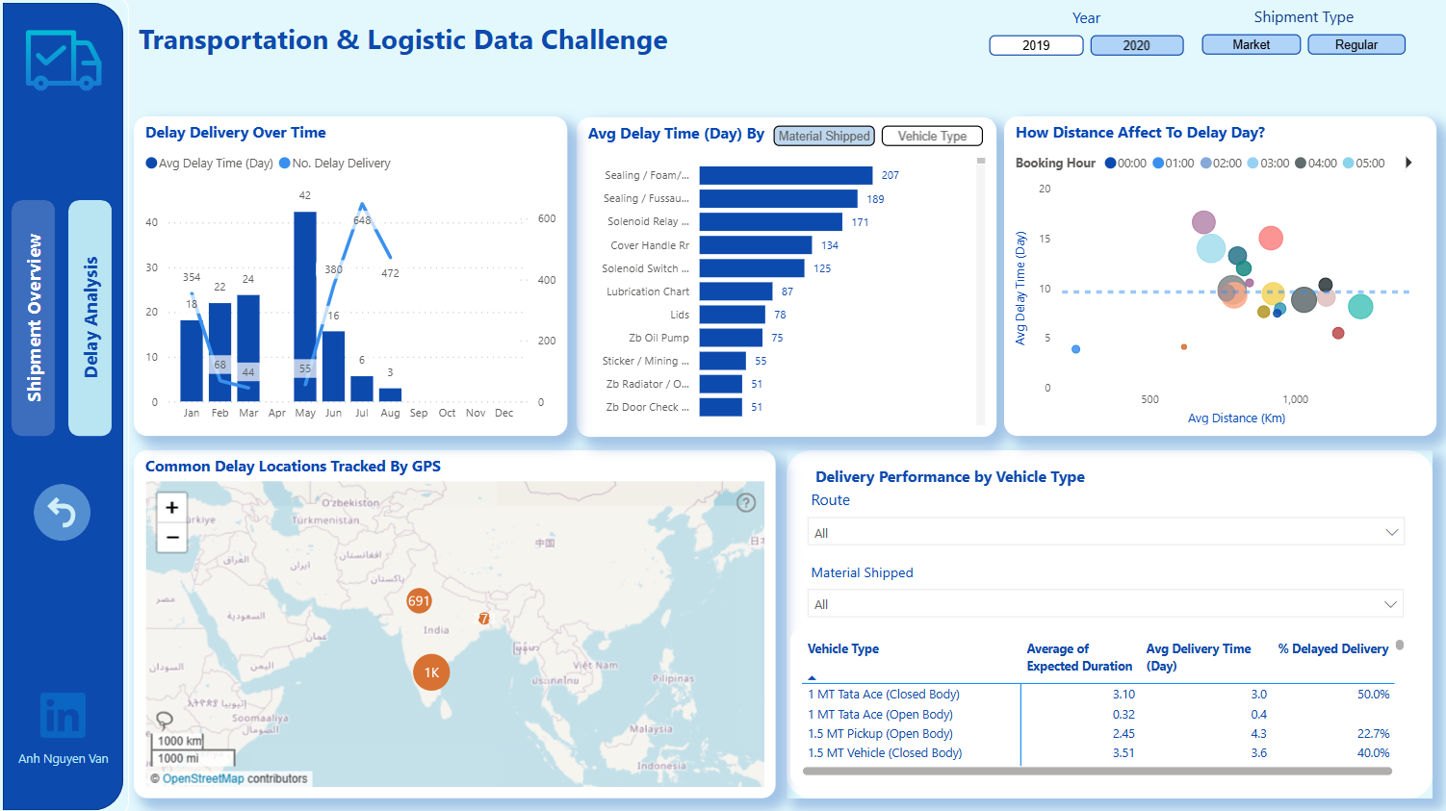
Transportation – FP20 Data Challenge
Link to Linkedin post by Anh Nguyen Van

Slide 5
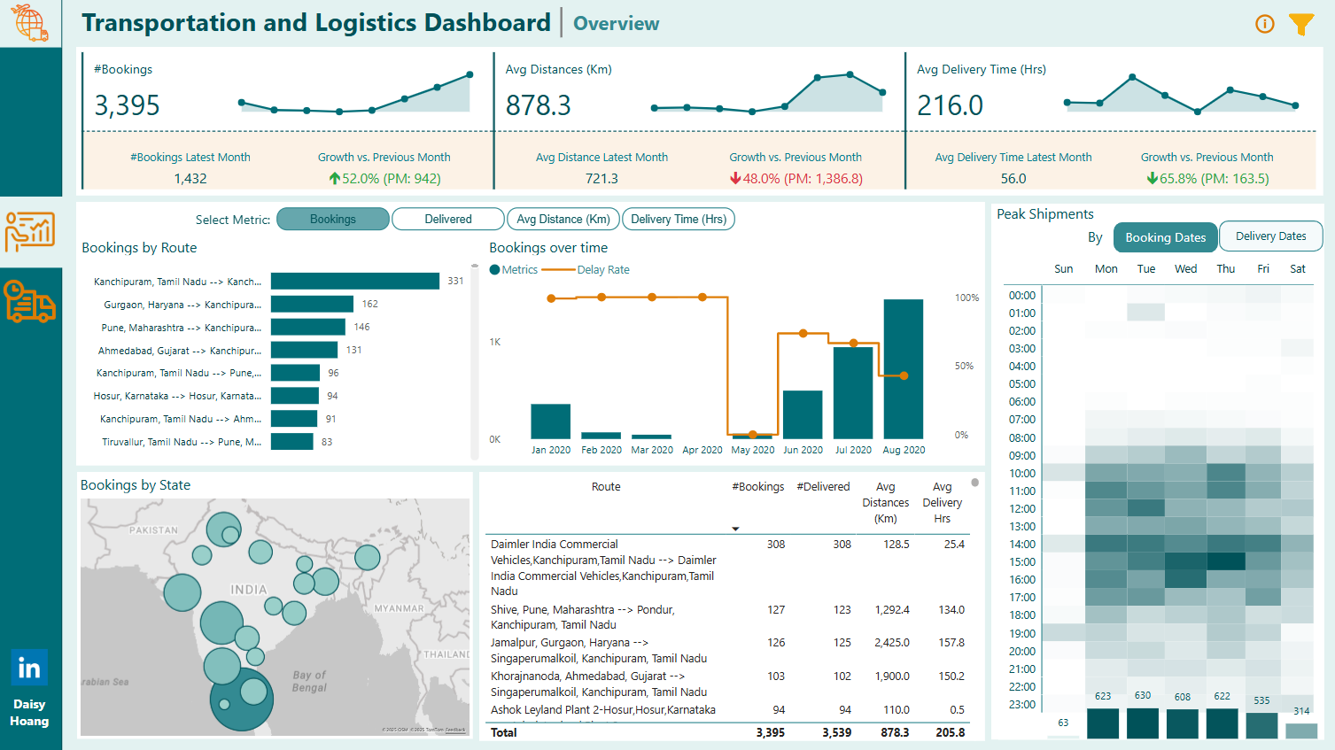
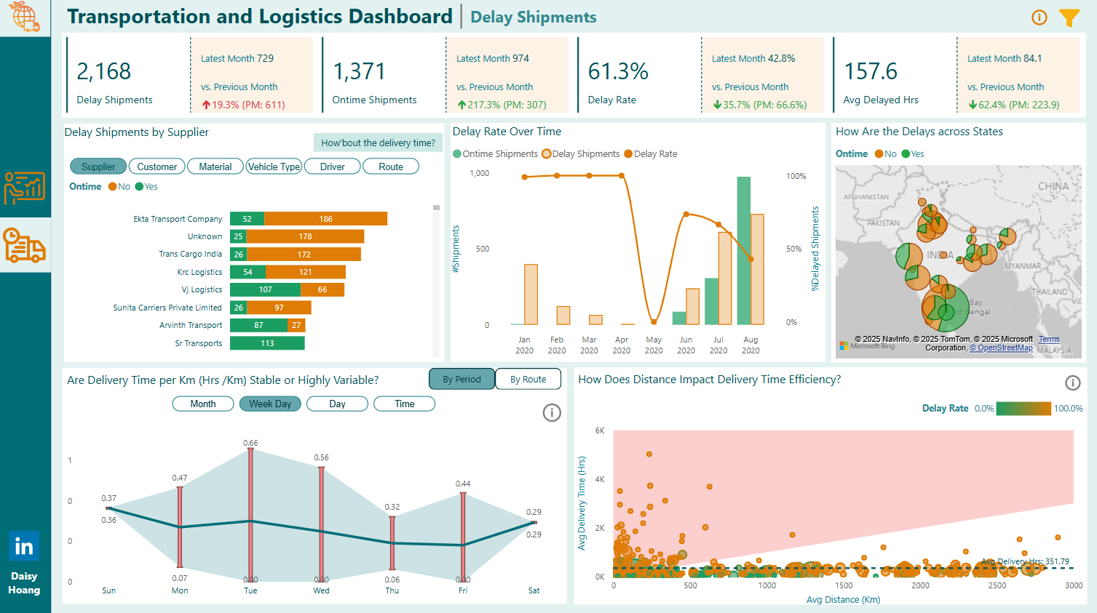
Transportation – FP20 Data Challenge
Link to Linkedin post by Duyen (Daisy) Hoang

Slide 6
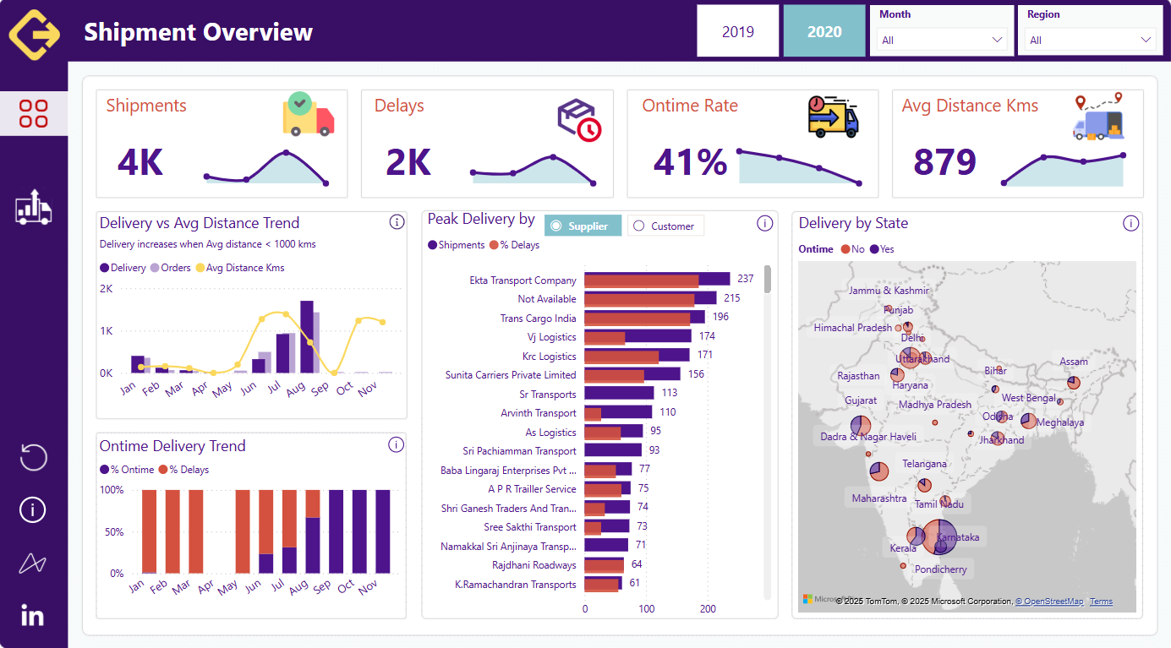
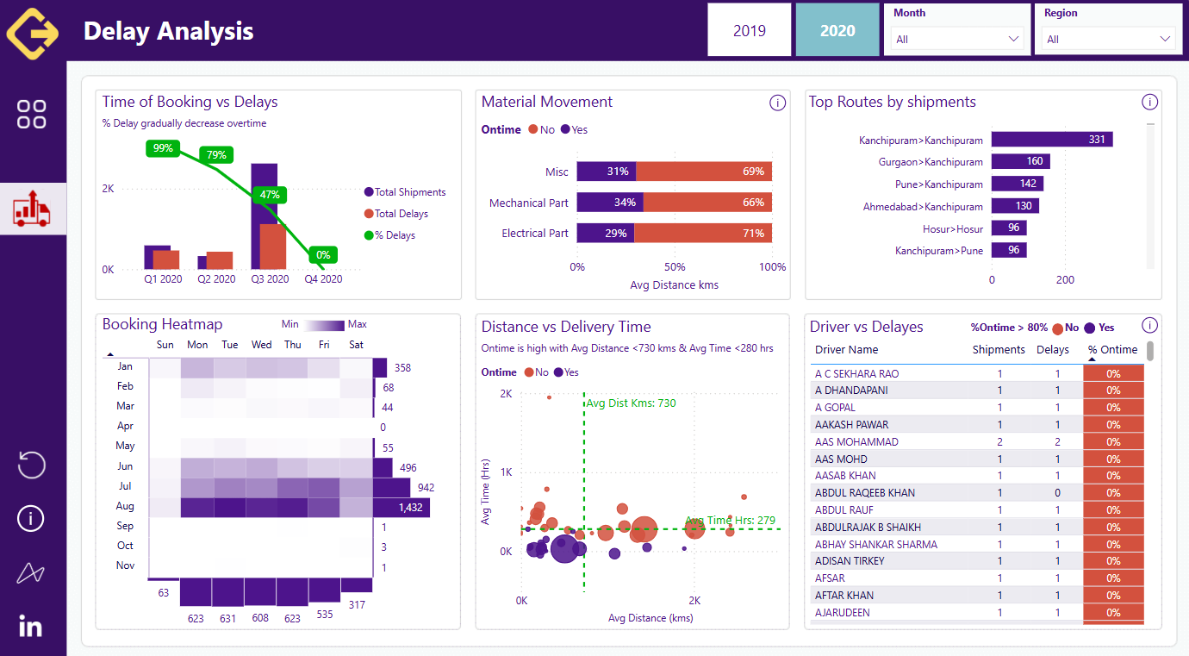
Transportation – FP20 Data Challenge
Link to Linkedin post by Kadir Amir

Slide 7
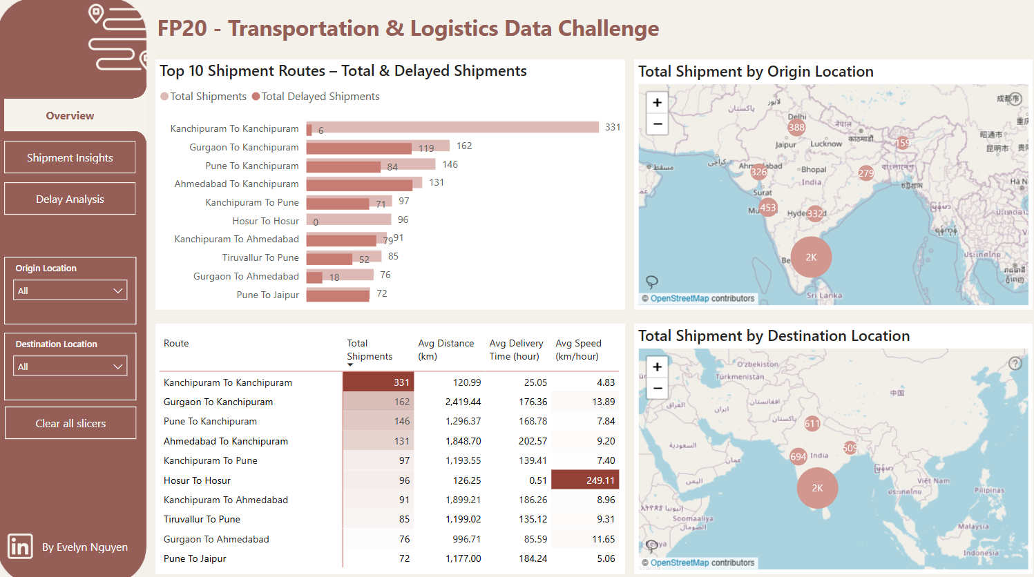
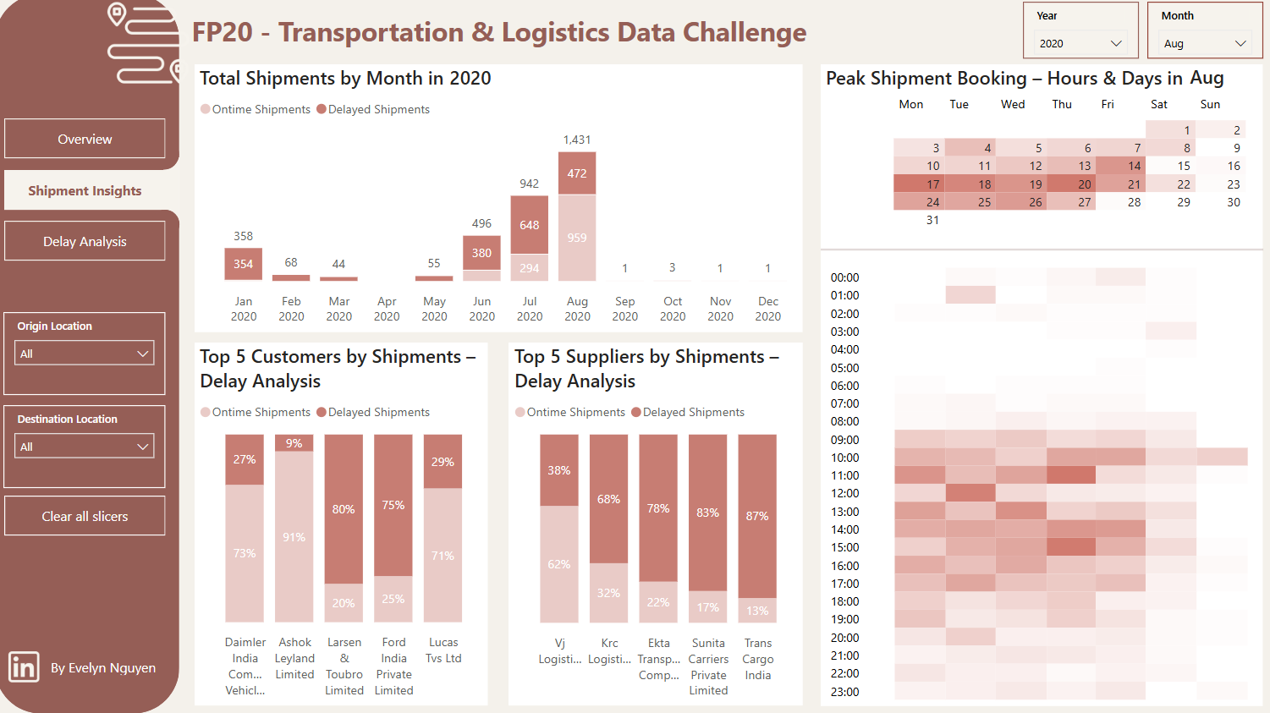
Transportation – FP20 Data Challenge
Link to Linkedin post by Evelyn Nguyen

Slide 8
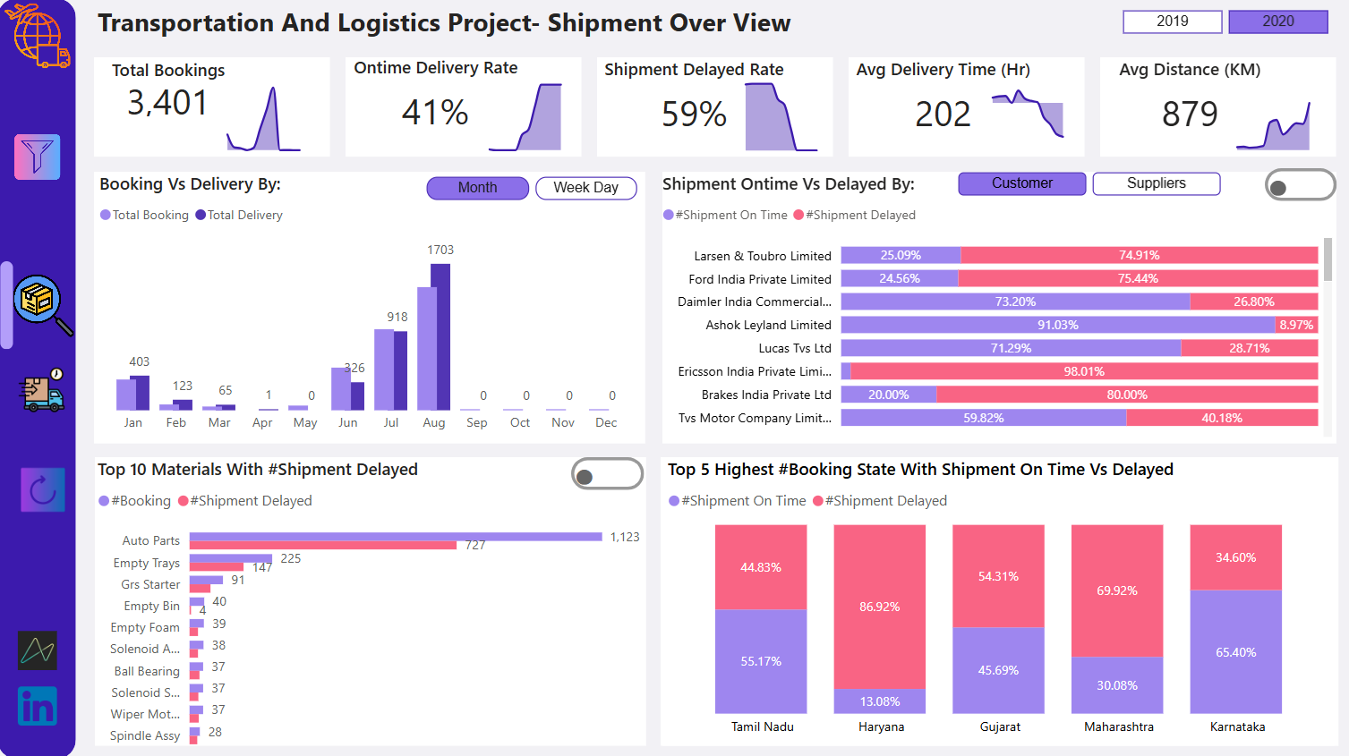
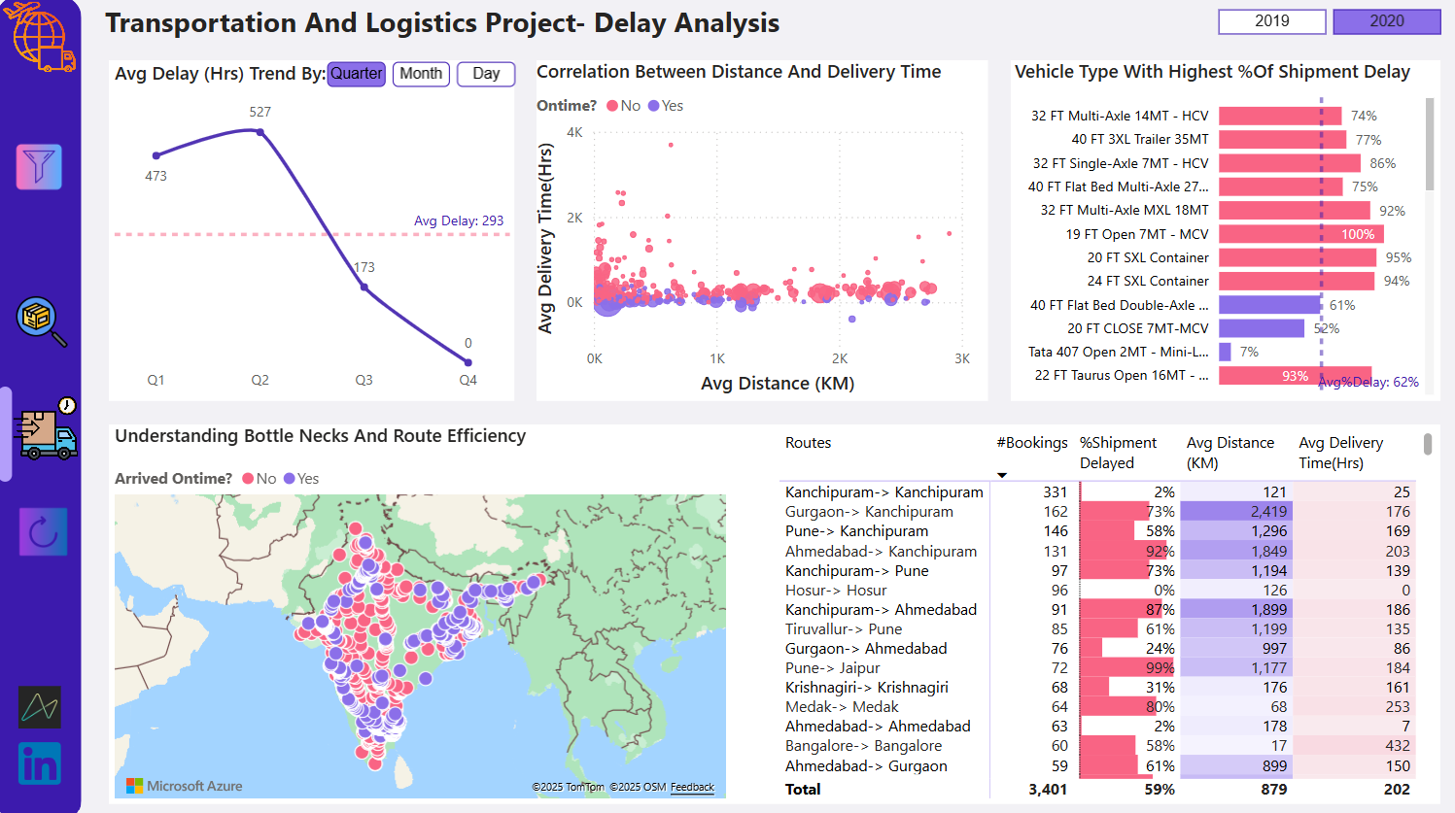
Transportation – FP20 Data Challenge
Link to Linkedin post by Tina Eswaradas

Slide 9
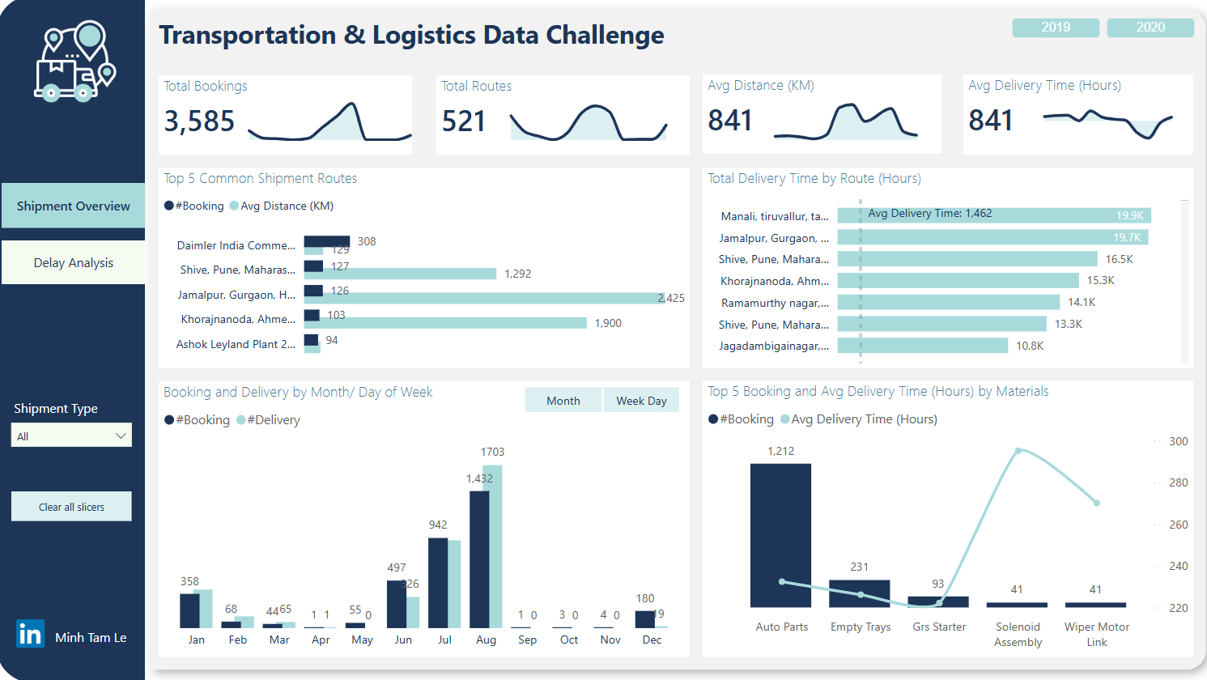
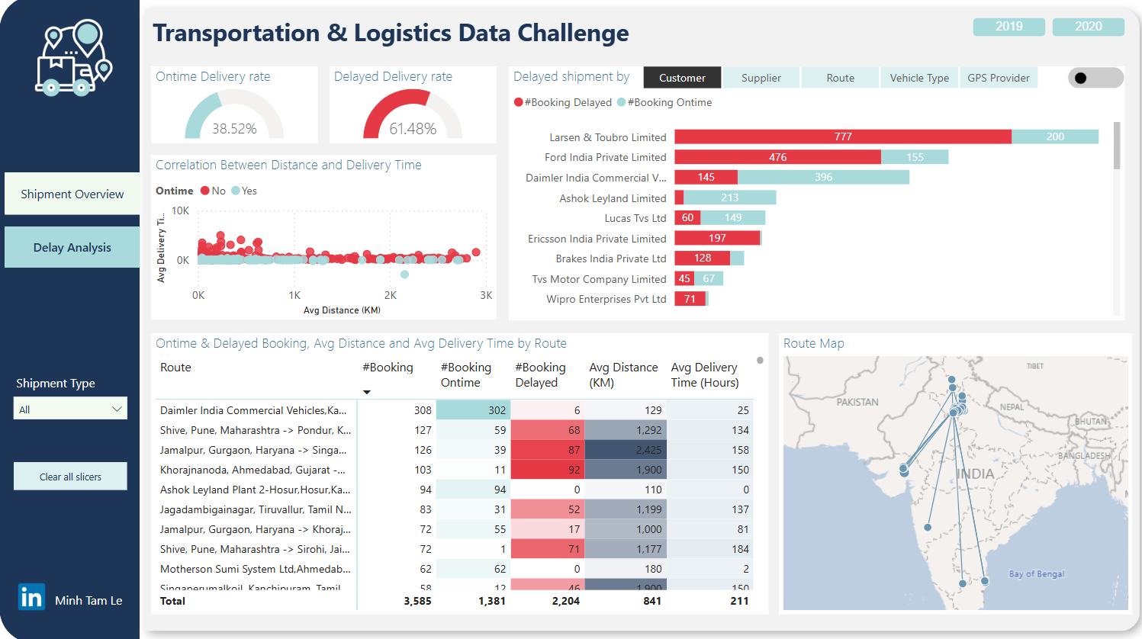
Transportation – FP20 Data Challenge
Link to Linkedin post by Minh Tam Le

Slide 10
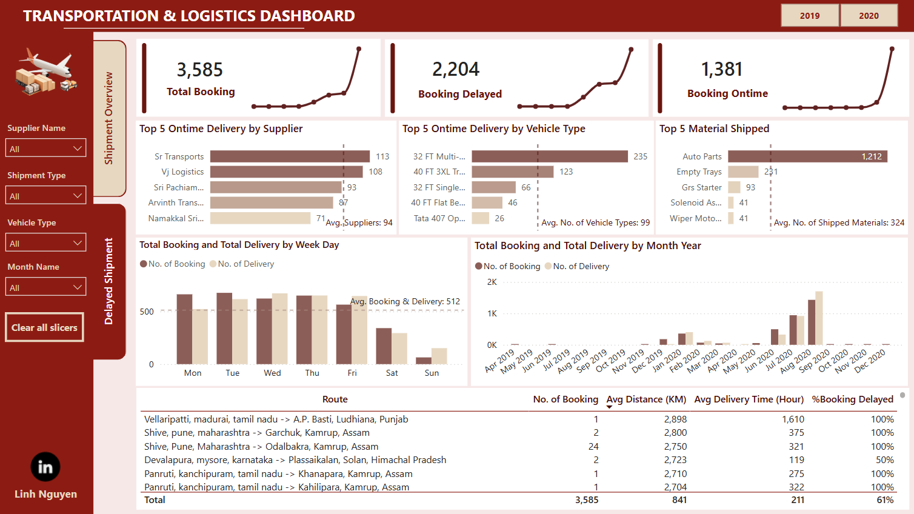
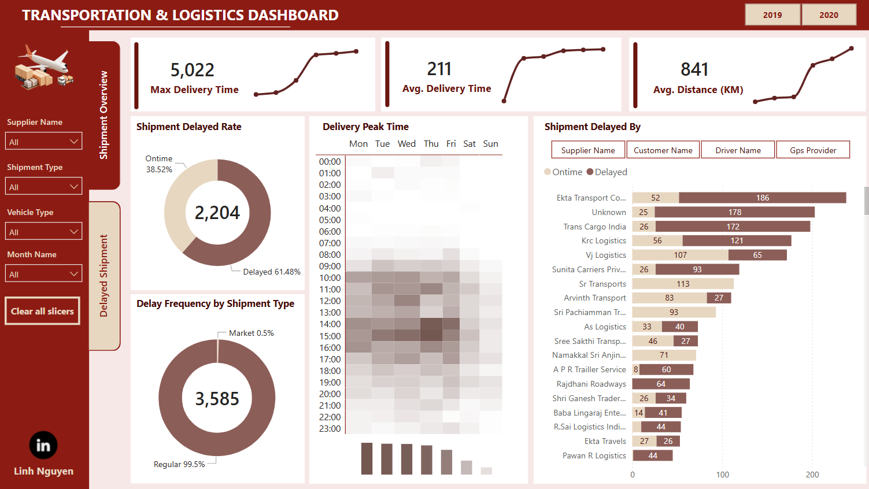
Transportation – FP20 Data Challenge
Link to Linkedin post by Linh Nguyen

Slide 11
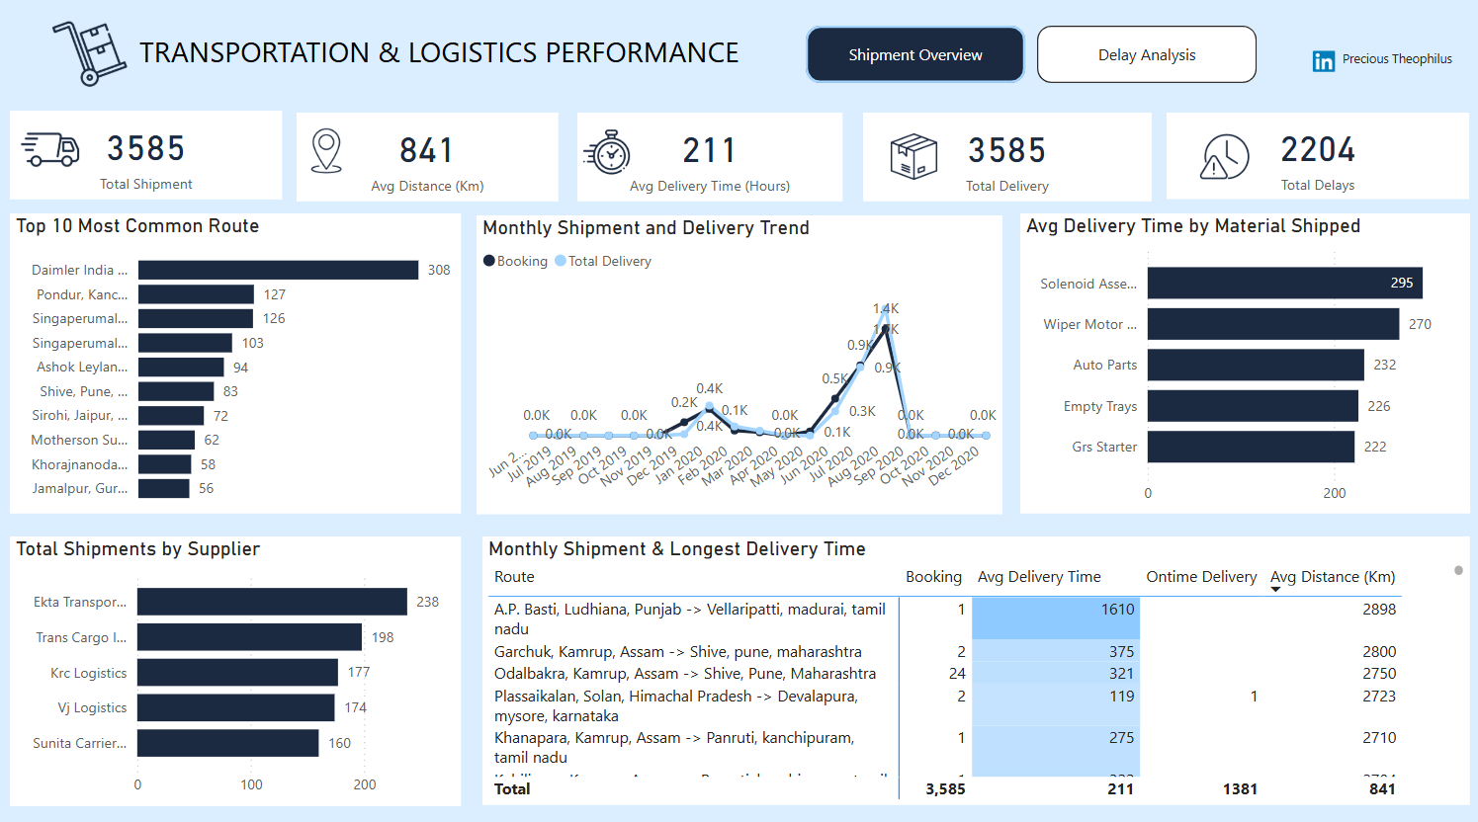
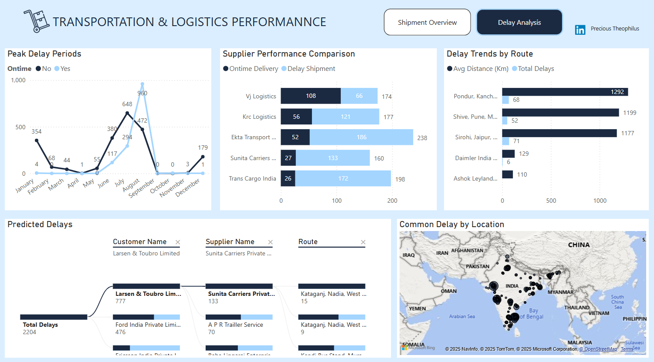
Transportation – FP20 Data Challenge
Link to Linkedin post by Precious Theophilus

Slide 12
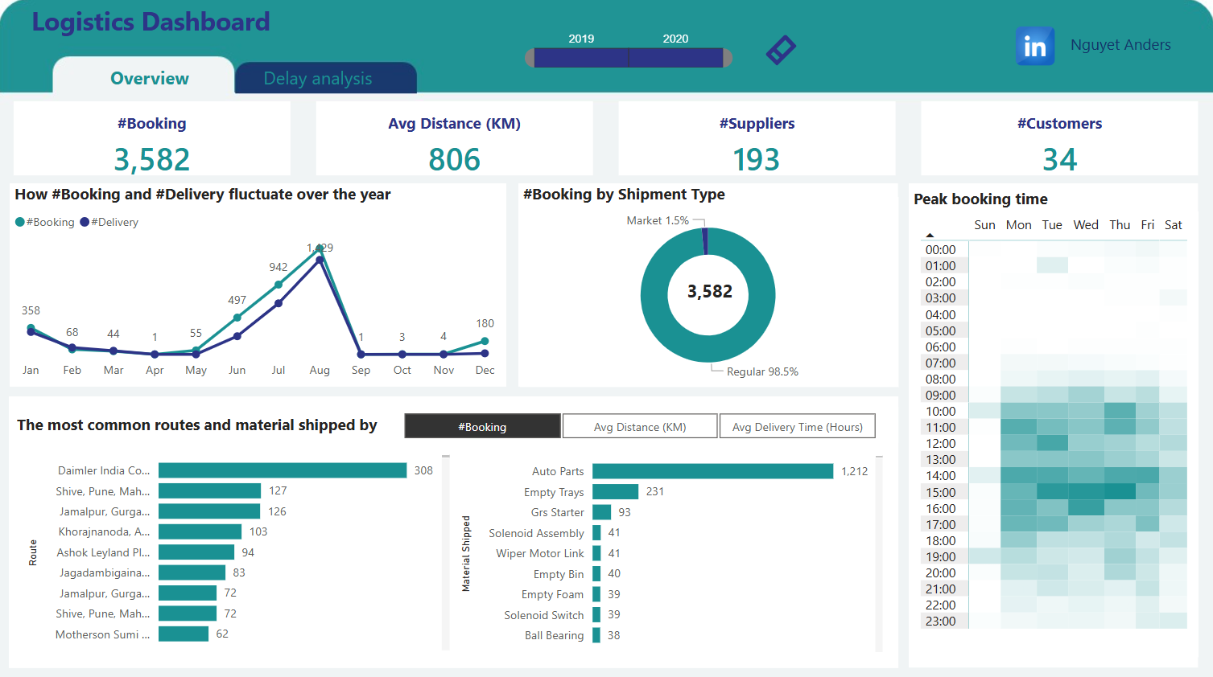
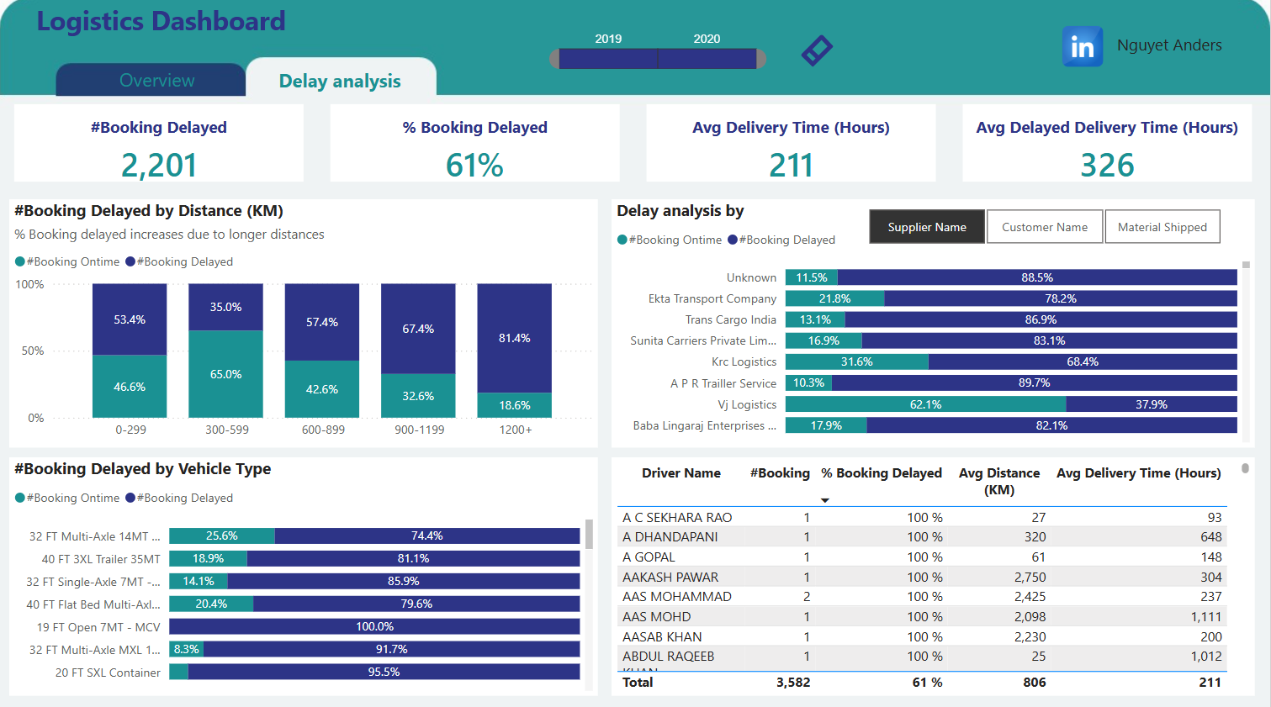
Transportation – FP20 Data Challenge
Link to Linkedin post by Nguyet Le

Slide 13
Thank you!
Anh Leimer
Any questions please contact me via:
Email: anh.leimer@gmail.com
Linkedin: Anh Leimer

